Slide 1

Lively 75th Anniversary
A Executive Presentation to City Council on Event Operations, Strategic Impact, and Long-Term Community Legacy

Slide 2

Governance & Strategy
Honoring seven-and-a-half decades of mining heritage, civic growth, and northern hospitality through strategic municipal partnership.

Slide 3






Core Governance Pillars
Indigenous Inclusion
Civic Engagement
Digital Archival
Collaborated directly with Atikameksheng Anishnawbek leadership to establish traditional opening protocols, regalia displays, and land honouring.
Secured primary sponsorship from Vale Base Metals and municipal transit and logistics support from the City of Greater Sudbury.
Launched Lively75th.ca to host permanent historical photo archives, town mapping records, and community oral histories.

Slide 4

Festival Weekend Highlights
July 10–12, 2026 Celebrations
•
VIP Pioneer Reception: Honoured founding families and hosted youth poetry award winners at T.M. Davies Arena.
•
75th Diamond Parade: High-capacity procession along 6th Ave featuring community floats and classic car displays.
•
Heritage Festival: Family activities, walking tours, and vendor hubs at Anderson Farm Museum.

Slide 5

Community Partnerships
Intergovernmental Alignment
Transit & Accessibility
Official recognition was formally presented via a Prime Minister's scroll delivered by MP Viviane Lapointe. Seamless coordination with Greater Sudbury Fire, EMS, and Police ensured a safe multi-venue footprint.
Partnered with GOVA Transit to provide free community shuttles connecting downtown Sudbury and Walden hubs directly to Anderson Farm and T.M. Davies Arena, maximizing regional attendance.

Slide 6


Key Impact Metrics
75
3
100%
Years of Heritage
Days of Events
Budget Compliant

Slide 7




Event Execution Schedule
Sat, July 11 AM
Sun, July 12
75th Anniversary Parade along 6th Ave to Anderson Farm.
Pancake Breakfast, Service & Site Restoration.
Fri, July 10
Sat, July 11 PM
VIP Reception & Decade Meet-and-Greet at T.M. Davies Arena.
Car Show, Live Music, Vendor Hub & Community Dance.

Slide 8
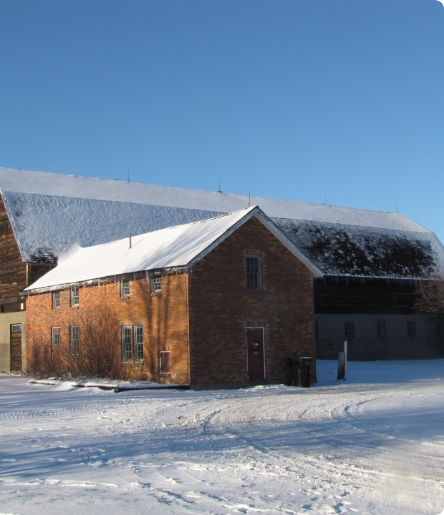
Heritage
Anderson Farm Museum
As the central venue for the Heritage Festival, Car Show, and walking tours, the Anderson Farm Museum served as a vital focal point for celebrating Lively's agricultural and mining history.
The committee strongly supports continued municipal investment in preserving this landmark site for community cultural events.

Slide 9
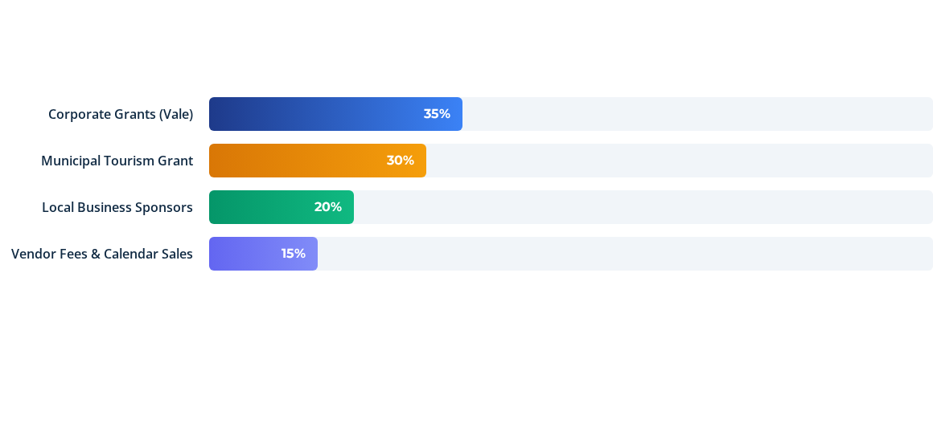
Revenue & Funding Summary
Operations concluded with full fiscal compliance, utilizing a balanced mix of corporate funding, municipal tourism grants, and local commercial support.

Slide 10
Committee Recommendations
Heritage Designation: Pursue formal Part IV designation under the Ontario Heritage Act for Anderson Farm to safeguard site history.
Digital Legacy Maintenance: Maintain Lively75th.ca as an active sub-domain under City of Greater Sudbury culture archives.
Asset Reallocation: Transfer remaining banners, historical displays, and event equipment to local historical societies and Kinsmen Hall.

Slide 11
Community Spirit
"From a planned mining town site in 1951 to the vibrant heart of the Walden area, Lively’s 75th celebrated decades of growth, resilience, and northern hospitality."
"
— Steering Committee Final Report

Slide 12
Questions & Discussion
Thank you to City Council, Municipal Staff, Sponsors, and Volunteers for making the Lively 75th Anniversary a memorable success.
Lively 75th Anniversary Steering Committee | www.Lively75th.ca

Slide 13


Image Sources
http://lively75th.ca/wp-content/uploads/2025/09/Screenshot-2025-09-11-at-01-26-59-Lively-75th-Anniversary-Logo-Date-Lively-75th-Anniversary-Logo
Source: lively75th.ca
https://museums.greatersudbury.ca/wp-content/uploads/2024/03/AFM-1-scaled.jpg
Source: museums.greatersudbury.ca

